Slide 1
Robotics
General Applications of AI
Delivery Robots and Drones

Slide 2
Outline
Introduction to AI in Robotics
Path Planning and Object Avoidance
Simultaneous Localization and Mapping
AI-based Real-Time Control
Use cases
Hands-On: Webots

Slide 3
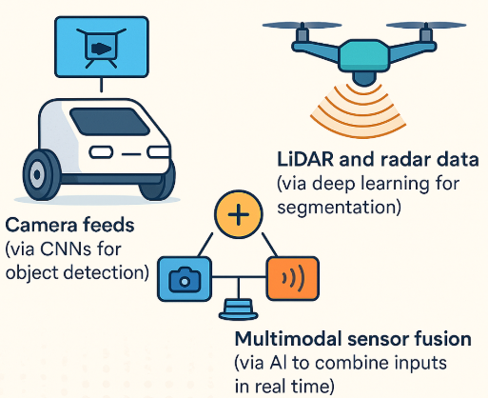
Introduction to AI in Robotics
How AI Enhances Autonomy in Mobile Robots and Drones
Perception & Sensing
AI enables robots to interpret complex environments using:
Camera feeds (via CNNs for object detection)
LiDAR and radar data (via deep learning for segmentation)
Multimodal sensor fusion (via AI to combine inputs in real time)

Slide 4
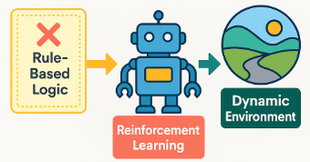
Introduction to AI in Robotics
How AI Enhances Autonomy in Mobile Robots and Drones
Decision Making
Traditional rule-based logic is replaced with reinforcement learning, allowing robots to learn optimal actions through interaction.
AI models can generalize to dynamic and uncertain environments, unlike static rules.

Slide 5
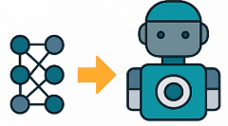
Introduction to AI in Robotics
How AI Enhances Autonomy in Mobile Robots and Drones
Navigation & SLAM
AI helps with real-time mapping and localization using semantic cues.
Deep learning-based feature extractors outperform traditional ones in Visual SLAM.

Slide 6
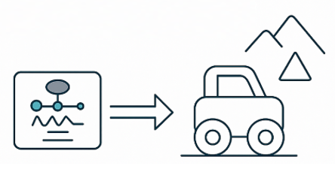
Introduction to AI in Robotics
How AI Enhances Autonomy in Mobile Robots and Drones
Motion Planning & Control
AI enables adaptive control using techniques like LSTM, DDPG, PPO.
Adjusts motion in response to terrain, obstacles, or tasks.

Slide 7
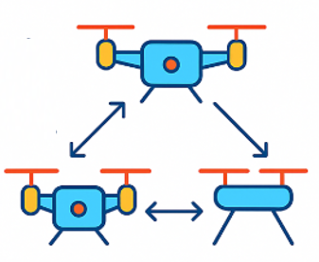
Introduction to AI in Robotics
How AI Enhances Autonomy in Mobile Robots and Drones
Autonomous Collaboration
Multi-robot coordination using AI (e.g., federated learning, swarm intelligence)
Drones share learned policies for coverage, delivery, or exploration.

Slide 8
Traditional vs AI-based Robotics
Component | Traditional Robotics | AI-Based Robotics
Perception | Rule-based image processing | Deep learning (e.g., YOLO, Mask R-CNN)
Localization (SLAM) | Feature-based (e.g., ORB, FAST) | Deep features + semantic understanding
Planning | A*, D*, graph search | RL-based (e.g., PPO, SAC, DQN)
Control | PID, fuzzy logic | Neural policies (LSTM, imitation learning)
Adaptability | Low (hard-coded rules) | High (learns from environment, generalizes)
Sensor Fusion | Kalman/Particle filter | Deep sensor fusion (CNN + RNNs)
Collaboration | Centralized or preprogrammed | Distributed learning, swarm intelligence

Slide 9
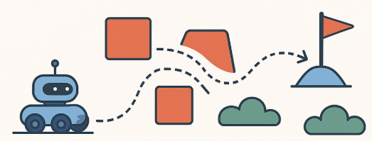
Path Planning and Object Avoidance
What is Path Planning?
Path Planning is the process by which a robot or autonomous system determines the optimal path from a start location to a goal location while avoiding obstacles.
Key Objectives:
Reach the goal safely
Minimize cost (distance, time, energy)
Adapt to dynamic or partially known environments

Slide 10
Path Planning and Object Avoidance
Path Planning Algorithms
Algorithm | Description | Strength
A* | Graph-based; uses heuristics to find the optimal path | Fast, deterministic
D* | Dynamic A* variant that replans on-the-fly | Ideal for changing environments
RRT (Rapidly Exploring Random Trees) | Probabilistic planner that quickly explores space | Great for high DOF robots
PRM (Probabilistic Roadmap) | Builds a roadmap of random paths in free space | Good for known environments

Slide 11
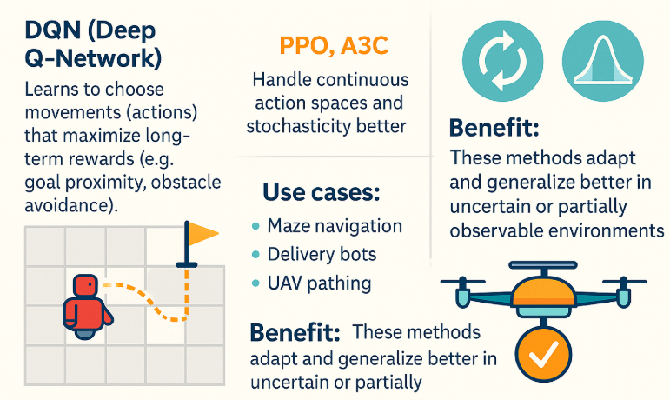
Path Planning and Object Avoidance
AI-Based Path Planning
DQN (Deep Q-Network): Learns to choose movements (actions) that maximize long-term rewards (e.g., goal proximity, obstacle avoidance).
PPO, A3C: Handle continuous action spaces and stochasticity better.
Use cases: Maze navigation, delivery bots, UAV pathing.
Benefit: These methods adapt and generalize better in uncertain or partially observable environments.

Slide 12
Path Planning and Object Avoidance
Obstacle Detection Techniques
Sensor | Role | AI Involvement
LiDAR | 2D/3D maps for obstacle layout | Point cloud segmentation via ML
Ultrasonic | Simple proximity detection | Threshold-based AI-assisted mapping
Camera | Detect objects visually | Object detection (YOLO, SSD, Mask R-CNN)
Infrared | Short-range binary detection | Useful for embedded bots

Slide 13
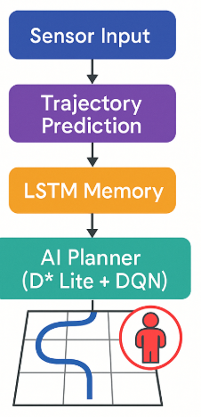
Path Planning and Object Avoidance
Dynamic Environments
AI helps:
Replan paths in real-time (D* Lite + DQN hybrid)
Avoid moving objects using trajectory prediction (e.g., pedestrian detection)
Fuse sensor input with memory (e.g., using LSTM)

Slide 14
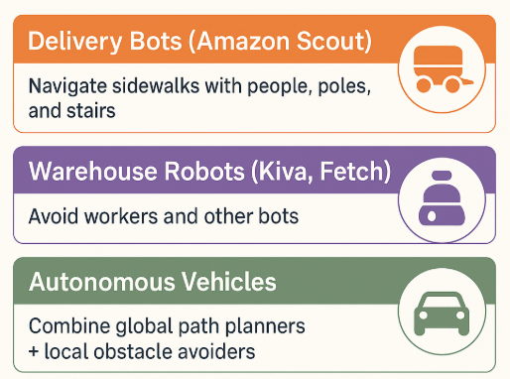
Path Planning and Object Avoidance
Real-World Applications
Delivery Bots (Amazon Scout): Navigate sidewalks with people, poles, and stairs
Warehouse Robots (Kiva, Fetch): Avoid workers and other bots
Autonomous Vehicles: Combine global path planners + local obstacle avoiders.

Slide 15
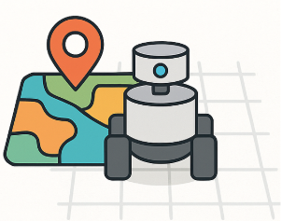
Simultaneous Localization and Mapping
What is SLAM?
SLAM is the process where a robot builds a map of an environment while simultaneously localizing itself within that map.
Used in: mobile robots, drones, autonomous cars, AR/VR systems
Problem:
Robot doesn’t know where it is
Robot also doesn’t have a map
But it must figure out both — at the same time

Slide 16
Simultaneous Localization and Mapping
Types of SLAM
Type | Input Sensor | Description
Visual SLAM | Monocular / Stereo cameras | Uses images to detect landmarks (ORB, SIFT, FAST)
LiDAR SLAM | 2D or 3D LiDAR | Builds precise point clouds, robust to lighting
Semantic SLAM | Camera + AI Models | Maps + labels objects (e.g., “door”, “table”) using neural networks

Slide 17
Simultaneous Localization and Mapping
SLAM Tools
Tool | Description | Sensor Type | AI Integration
ORB-SLAM3 | Feature-based; supports mono, stereo, RGB-D | Camera | Deep features possible
GMapping | Particle filter-based 2D SLAM | LiDAR | Classical
RTAB-Map | Real-Time Appearance-Based Mapping | RGB-D + LiDAR | Supports CNNs + loop closure optimization

Slide 18
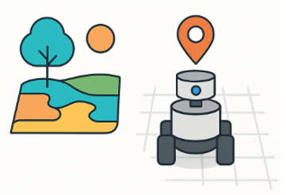
Simultaneous Localization and Mapping
Loop Closure & Feature Extraction (AI’s Role)
Feature Extraction:
AI-based: CNNs or SuperPoint extract more robust and consistent visual features in challenging lighting
Loop Closure:
Robot detects it has returned to a previously visited place
AI improves accuracy using place recognition models (e.g., NetVLAD, DeepLoop)

Slide 19

Simultaneous Localization and Mapping
Loop Closure & Feature Extraction (AI’s Role)
Traditional SLAM works well, but AI boosts performance in:
Feature detection
Data association
Place recognition
SLAM remains a cornerstone of robotics autonomy

Slide 20
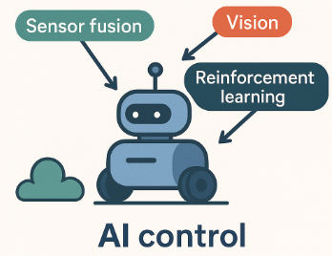
AI-based Real-Time Control
AI algorithms enhance robot control beyond traditional PID systems using sensor fusion, vision, and reinforcement learning

Slide 21
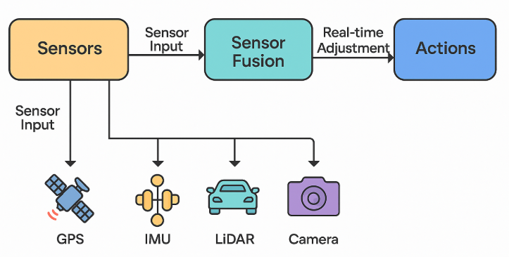
AI-based Real-Time Control
Sensor Fusion + AI for Path Correction
Sensor Fusion: Combines data from multiple sources — IMU, GPS, LiDAR, camera — into a single coherent understanding of state.
AI Controllers use sensor fusion to:
Adjust trajectories dynamically
Correct for wheel slippage, drift, or turbulence
LSTM: Remembers temporal movement patterns for smoother control
DDPG (Deep Deterministic Policy Gradient): Continuous control for steering and thrust
PPO (Proximal Policy Optimization): Stable learning in complex action spaces (used in quadrupeds, drones)

Slide 22
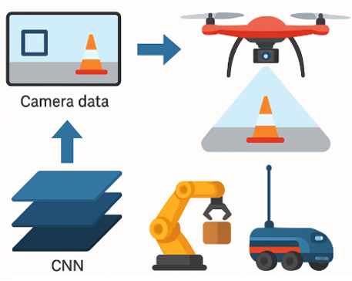
AI-based Real-Time Control
Use of CNNs for Visual Servoing
Visual servoing is the use of camera data to guide robot motion in real time.
How CNNs Help:
Detect visual markers, object edges, or landmarks
Learn end-to-end control from images → wheel/thrust commands
Used in:
Drone landing
Arm-based object grasping
Vision-guided AGVs (Autonomous Guided Vehicles)

Slide 23
AI-based Real-Time Control
PID vs AI-Based Controllers in Rough Terrain
Controller Type | How It Works | Strength | Weakness
PID | Proportional-Integral-Derivative | Simple, fast | Fails in non-linear, dynamic terrain
AI-Based (e.g., RL) | Learns optimal control via rewards | Adapts to slip, incline, load changes | Requires training data & compute

Slide 24
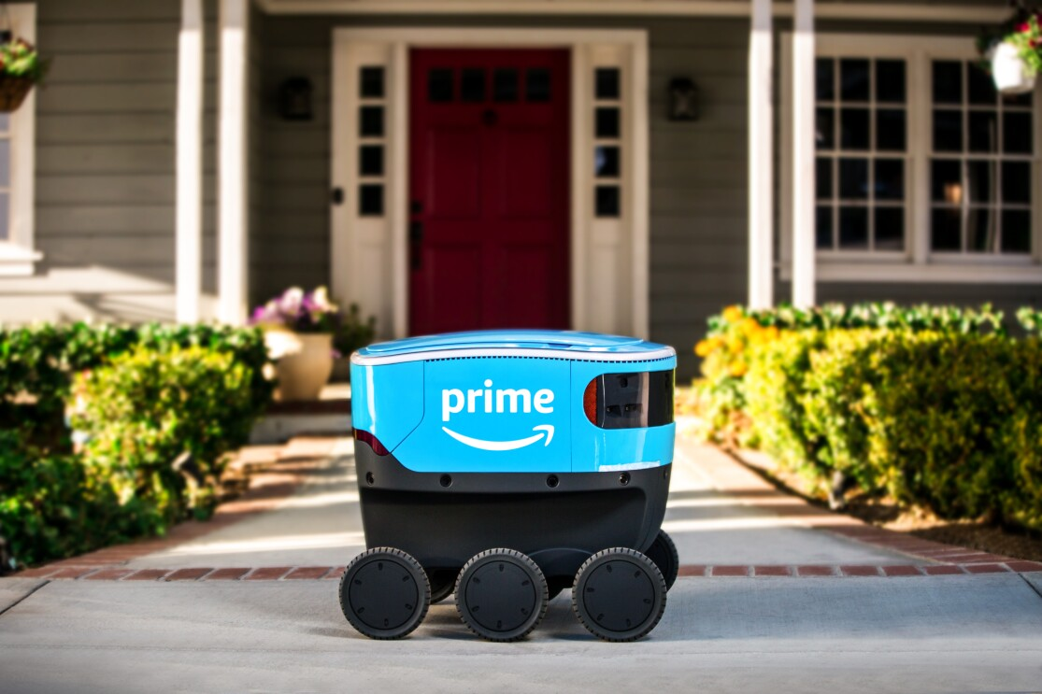
Use cases: Amazon Scout
Amazon Scout – Autonomous Last-Mile Delivery Bot
Amazon Scout is a six-wheeled, fully electric delivery robot designed for sidewalks and pedestrian pathways. It autonomously delivers packages to customers’ homes in urban and suburban neighborhoods.

Slide 25
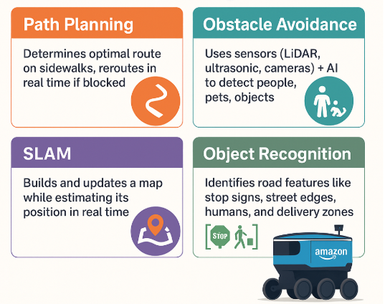
Use cases: Amazon Scout
Key AI Technologies:
Path Planning: Determines optimal route on sidewalks, reroutes in real-time if blocked
Obstacle Avoidance: Uses sensors (LiDAR, ultrasonic, cameras) + AI to detect people, pets, objects.
SLAM: Builds and updates a map while estimating its position in real-time.
Object Recognition: Identifies road features like stop signs, street edges, humans, and delivery zones

Slide 26
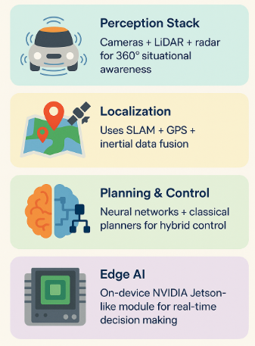
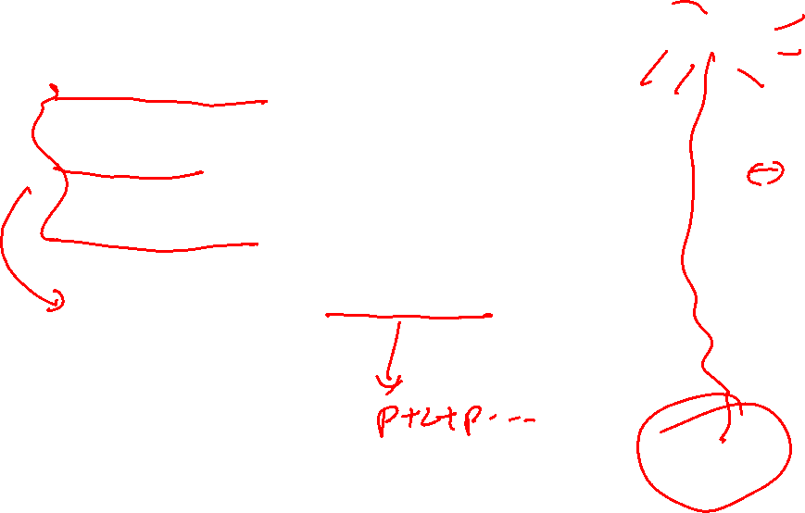
Use cases: Amazon Scout
Architecture Snapshot:
Perception Stack: Cameras + LiDAR + radar for 360° situational awareness
Localization: Uses SLAM + GPS + inertial data fusion
Planning & Control: Neural networks + classical planners for hybrid control
Edge AI: On-device NVIDIA Jetson-like module for real-time decision making

Slide 27
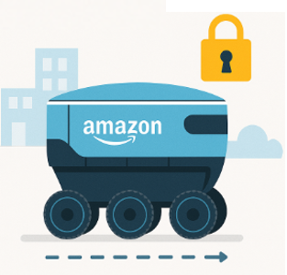
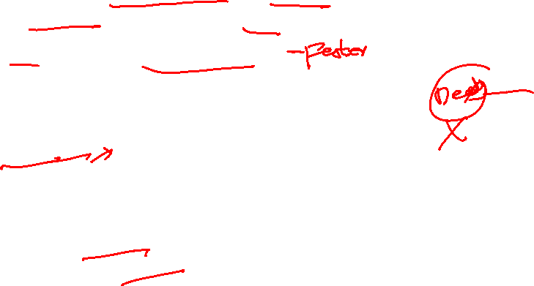
Use cases: Amazon Scout
Real Deployment:
Piloted in Washington, California, Tennessee, and other U.S. regions
Operates at walking speed
Only opens for verified recipients via app-based unlock
Impact:
Reduces carbon emissions in last-mile delivery
Cuts delivery cost and increases scalability in dense neighborhoods
Demonstrates practical Edge-AI + robotics integration

Slide 28
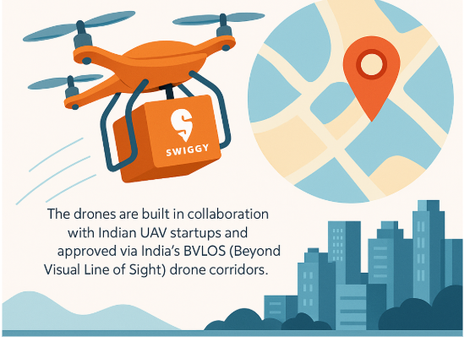

Use cases: Swiggy Drones
Swiggy Drones – Food Delivery via Autonomous UAVs
Swiggy, one of India’s largest food delivery platforms, has initiated drone-based food delivery pilots to improve delivery times, especially in traffic-congested or remote areas.
The drones are built in collaboration with Indian UAV startups and approved via India's BVLOS (Beyond Visual Line of Sight) drone corridors.

Slide 29
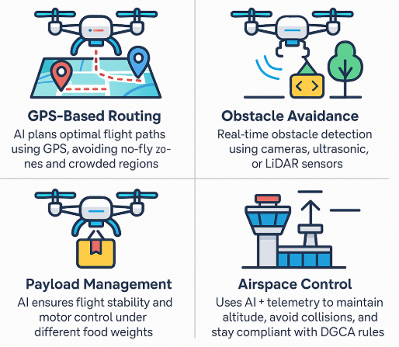

Use cases: Swiggy Drones
Core AI-Driven Technologies
GPS-Based Routing: AI plans optimal flight paths using GPS, avoiding no-fly zones and crowded regions: Real-time obstacle detection using cameras, ultrasonic, or LiDAR sensors
Obstacle Avoidance: Real-time obstacle detection using cameras, ultrasonic, or LiDAR sensors
Payload Management: AI ensures flight stability and motor control under different food weights
Airspace Control: Uses AI + telemetry to maintain altitude, avoid collisions, and stay compliant with DGCA rules

Slide 30


Use cases: Swiggy Drones
System Architecture
Flight Controller: Autopilot hardware (e.g., PX4 or ArduPilot)
Navigation: RTK-GPS for centimeter-level accuracy
AI Modules: Onboard Edge AI (Jetson Nano/Xavier) for visual detection and dynamic rerouting
Delivery Mechanism: Winch/drop system or box release for contactless delivery
Fleet Management: Central cloud AI system monitors and coordinates multiple drones

Slide 31


Use cases: Swiggy Drones
Deployment Context (India)
Trials conducted in cities like Bangalore, Hyderabad, and Gurugram
Supported by Ministry of Civil Aviation under Drone Rules 2021
Operates under BVLOS experimental permissions for food & medicine delivery

Slide 32
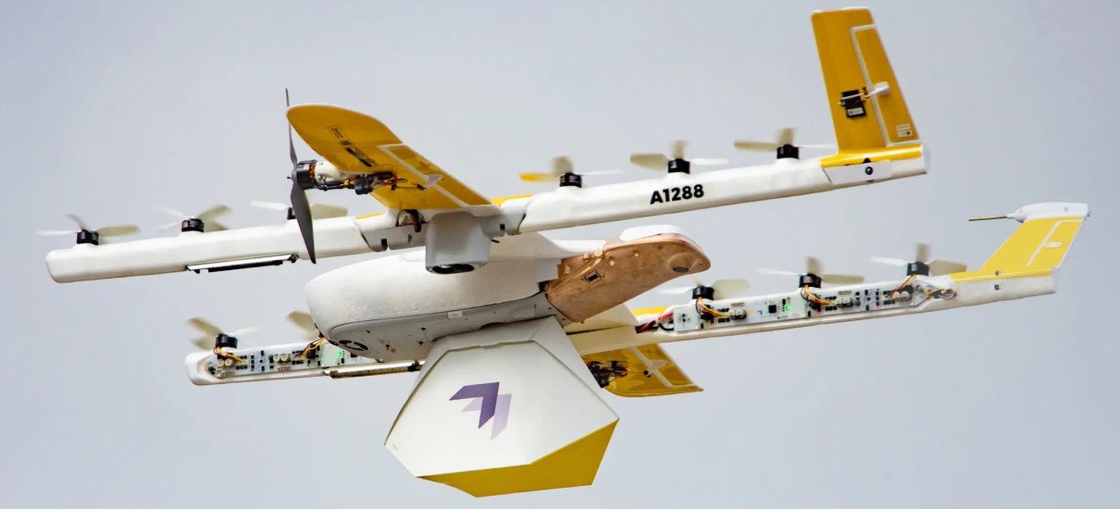
Use cases: Wing (by Google)
Wing (by Google) – Autonomous Drone Delivery
Wing is an Alphabet (Google's parent company) subsidiary that operates autonomous delivery drones for lightweight goods like groceries, medicines, and parcels.
The system is fully AI-driven and supports autonomous navigation, obstacle avoidance, and precise payload delivery.
Wing operates commercially in the USA, Australia, and Finland.

Slide 33
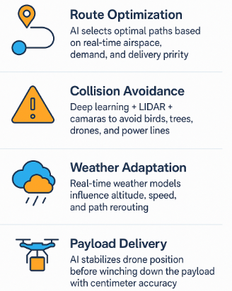
Use cases: Wing (by Google)
Key AI Capabilities
Route Optimization: AI selects optimal paths based on real-time airspace, demand, and delivery priority.
Collision Avoidance: Deep learning + LiDAR + cameras to avoid birds, trees, drones, and power lines.
Weather Adaptation: Real-time weather models influence altitude, speed, and path rerouting.
Payload Delivery: AI stabilizes drone position before winching down the payload with centimeter accuracy.

Slide 34
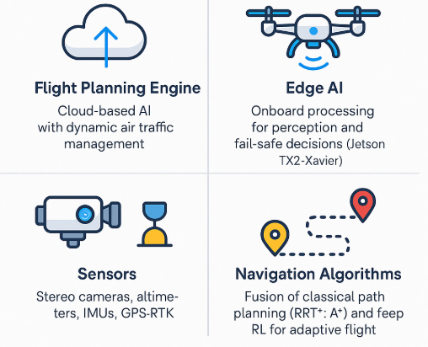
Use cases: Wing (by Google)
Architecture Overview
Flight Planning Engine: Cloud-based AI with dynamic air traffic management
Edge AI: Onboard processing for perception and fail-safe decisions (Jetson TX2/Xavier)
Sensors: Stereo cameras, altimeters, IMUs, GPS-RTK
Navigation Algorithms: Fusion of classical path planning (RRT*, A*) and deep RL for adaptive flight

Slide 35

Use cases: Wing (by Google)
Deployment Use Cases
Logan, Australia: Groceries and fast food in suburban areas
Christiansburg, USA: Medical and personal care items
Helsinki, Finland: General e-commerce, grocery items
Wing delivers in <6 minutes with fully autonomous takeoff, flight, and landing.

Slide 36
THANK YOU

